Slide 1
Camera Calibration with
Matlab 2018
Li Wei
School of Automation Engineering, UESTC

Slide 2
Steps
Prepare images
Add images
Calibrate the camera
Evaluate calibration accuracy
Improve accuracy
Export the parameters object.

Slide 3
Prepare Images

Slide 4

Prepare the Checkerboard Pattern
one side must contain an even number of squares and the other side must contain an odd number of squares
the calibrator assigns the longer side to be the x-direction

Slide 5
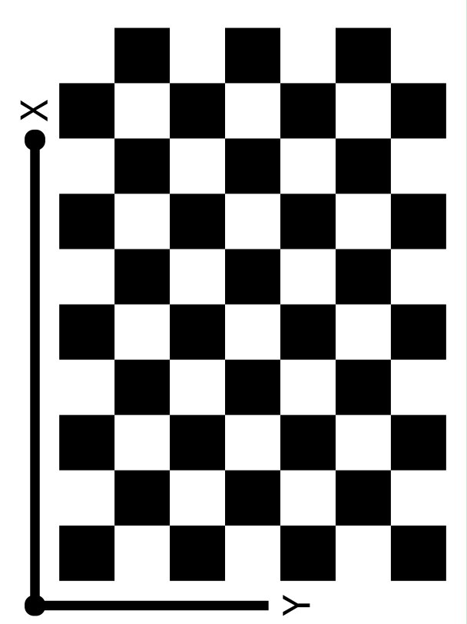
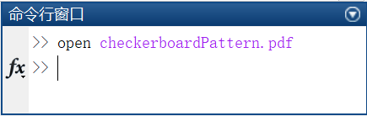
Prepare the Checkerboard Pattern
• get checkerboard patten from Matlab
>> open checkerboardPattern.pdf

Slide 6
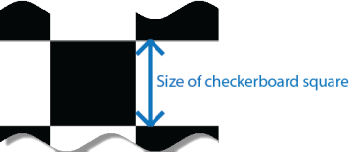
Prepare the Checkerboard Pattern
• attach the checkerboard printout to a flat surface
• measure one side of the checkerboard square
• little background clutter

Slide 7

Camera Setup
Note:
• keep the pattern in focus, but do not use autofocus
• do not change the zoom settings between images

Slide 8
Capture Images
Essential requirements :
• use at least 10 to 20 images of the calibration pattern
• the calibrator requires at least three images.
• use uncompressed images or images in lossless compression formats such as PNG.
Note:
• do not modify the images. for example, do not crop them.

Slide 9
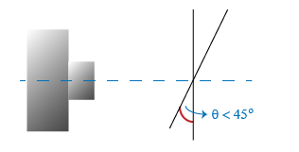
Capture Images
For greater calibration accuracy :
• capture the images of a checkerboard pattern at different orientations relative to the camera.
• capture the images of the pattern at a distance roughly equal to the distance from your camera to the objects of interest
• place the checkerboard at an angle less than 45 degrees relative to the camera plane

Slide 10
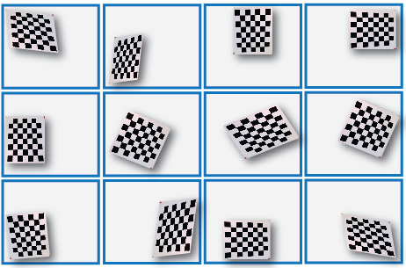
Capture Images
For greater calibration accuracy:
• to capture as much lens distortion as possible, the pattern must appear close to the edges of the captured images

Slide 11
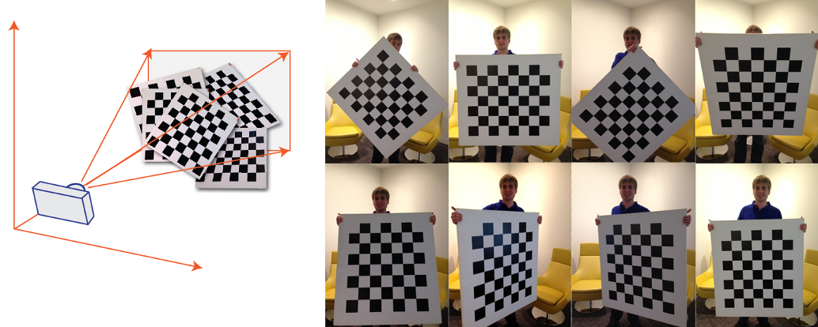
Capture Images
For greater calibration accuracy :
• as a general rule, your checkerboard should fill at least 20% of the captured image.

Slide 12
Add Images

Slide 13
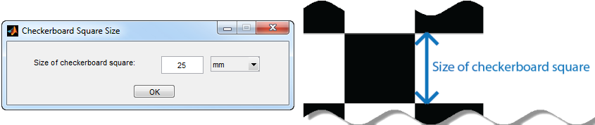
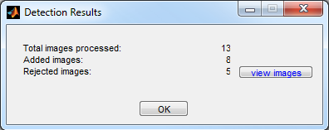
Add and Analyze Images
• specify size of the checkerboard square by entering the length of one side of a square from the checkerboard pattern.
• The calibrator attempts to detect a checkerboard in each of the added images

Slide 14
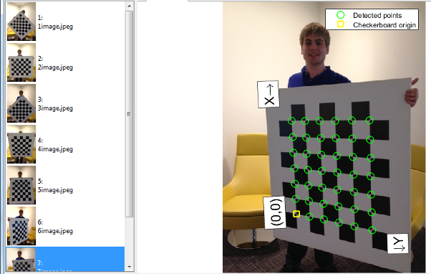
View Images and Detected Points
• all the images are given IDs and these images contain a detected pattern.

Slide 15
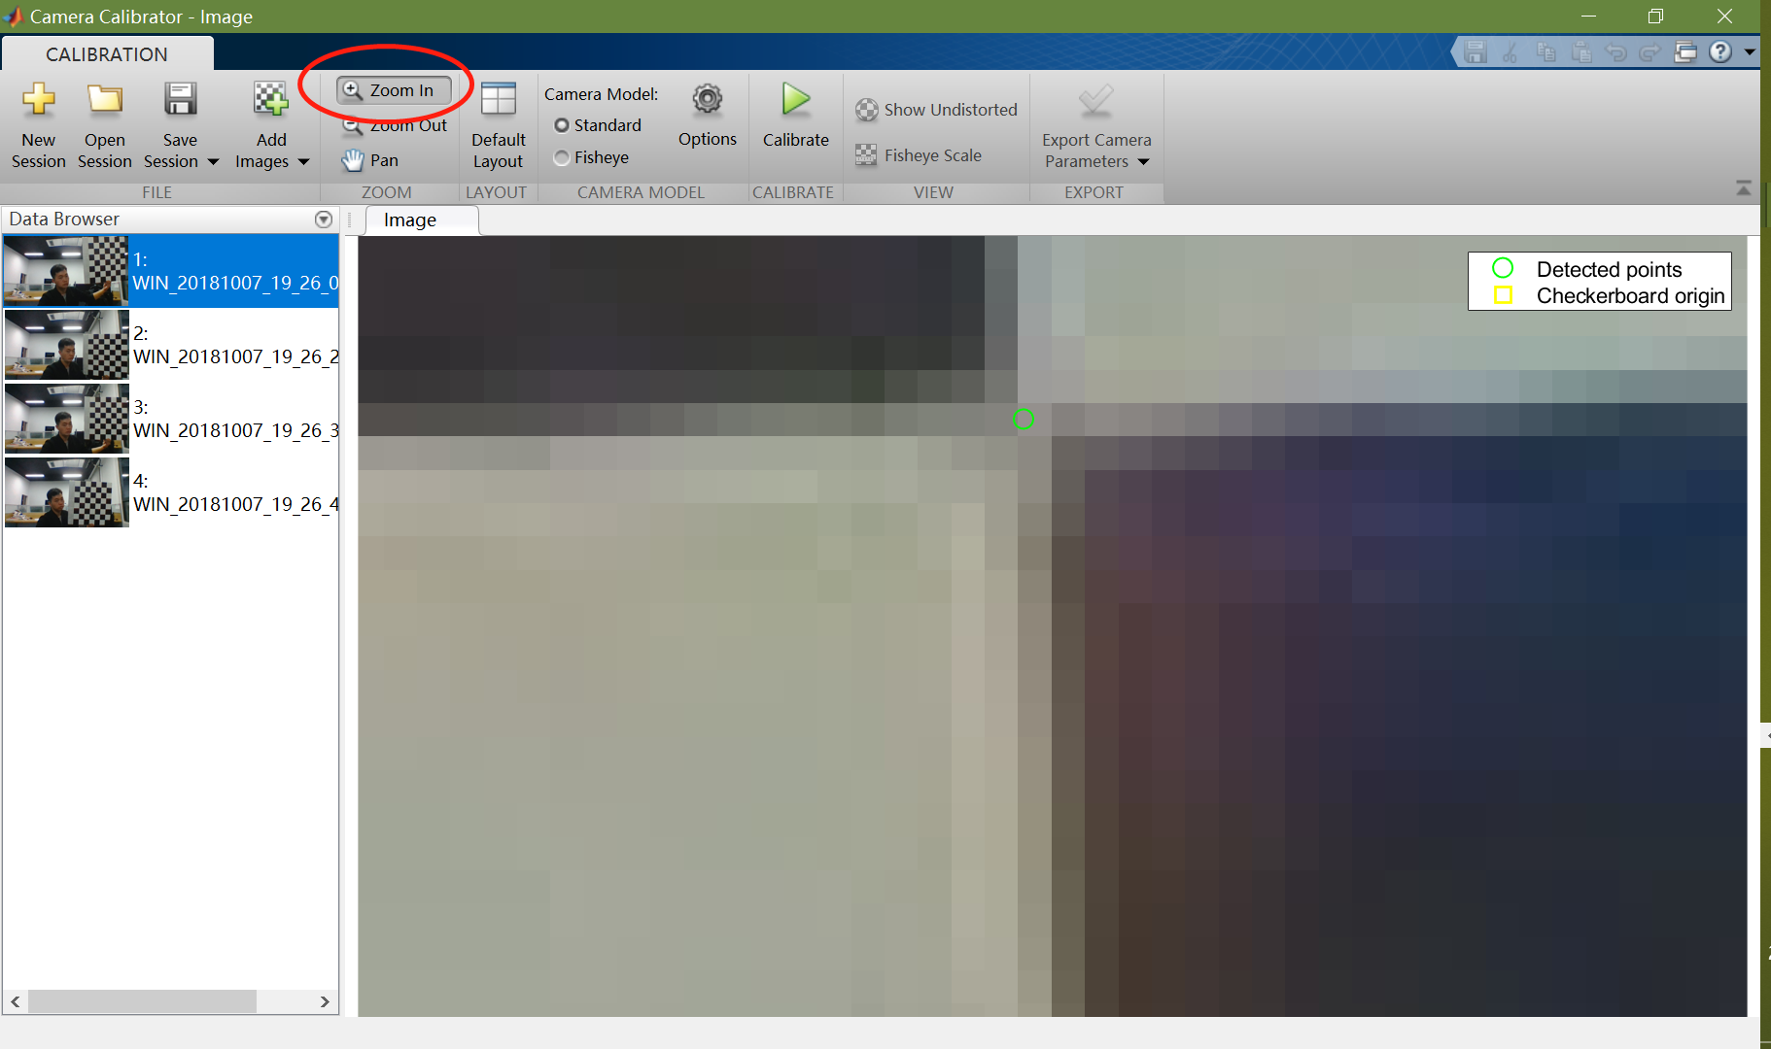
View Images and Detected Points
• we can verify that the corners were detected correctly using the zoom controls

Slide 16
Calibrate the Camera

Slide 17
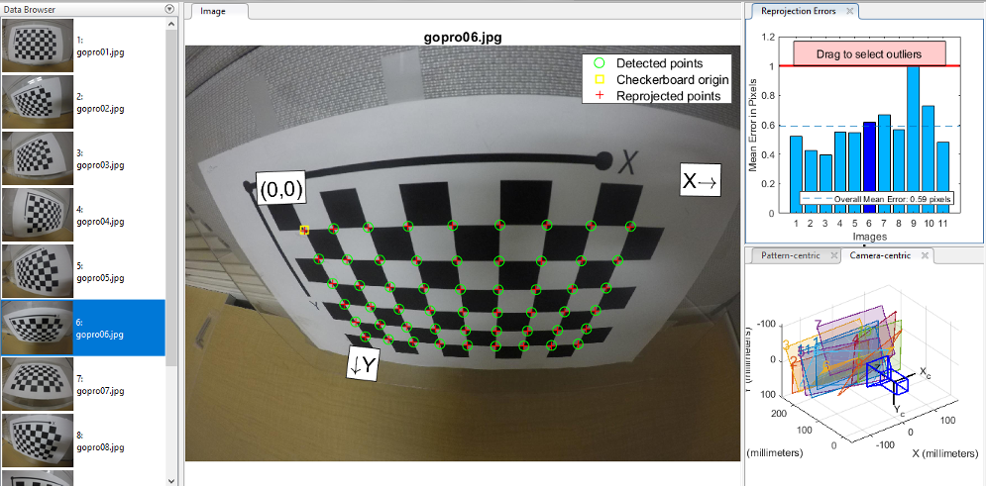
Calibrate the camera
• once you are satisfied with the accepted images, click the Calibrate button on the calibration tab.

Slide 18
Evaluate Calibration Accuracy

Slide 19
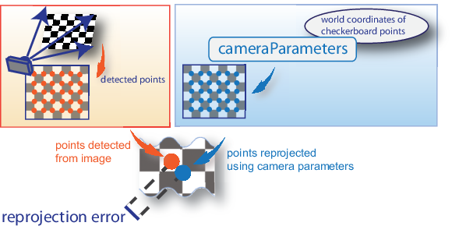
Examine Reprojection Errors
• the reprojection errors are the distances, in pixels, between the detected and the reprojected points.

Slide 20
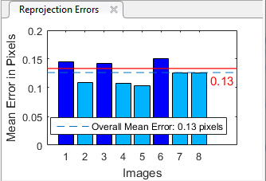
Examine Reprojection Errors
• mean reprojection errors of less than one pixel are acceptable

Slide 21
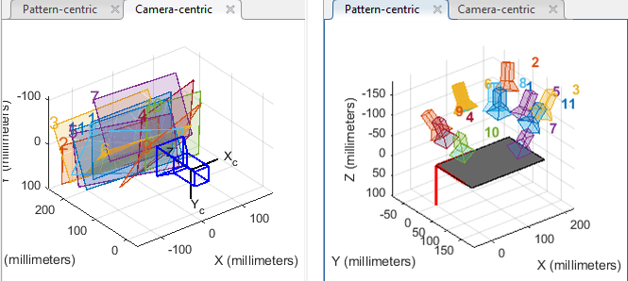
Examine Extrinsic Parameter Visualization
• The camera-centric view is helpful if the camera was stationary when the images were captured. The pattern-centric view is helpful if the pattern was stationary.

Slide 22
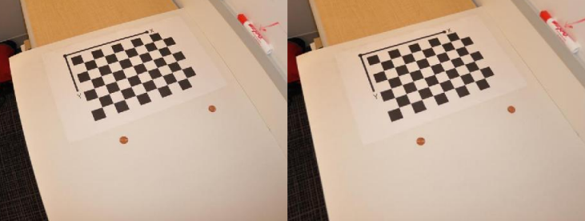
View Undistorted Image
• If the calibration was accurate, the distorted lines in the image become straight.

